Slide 1
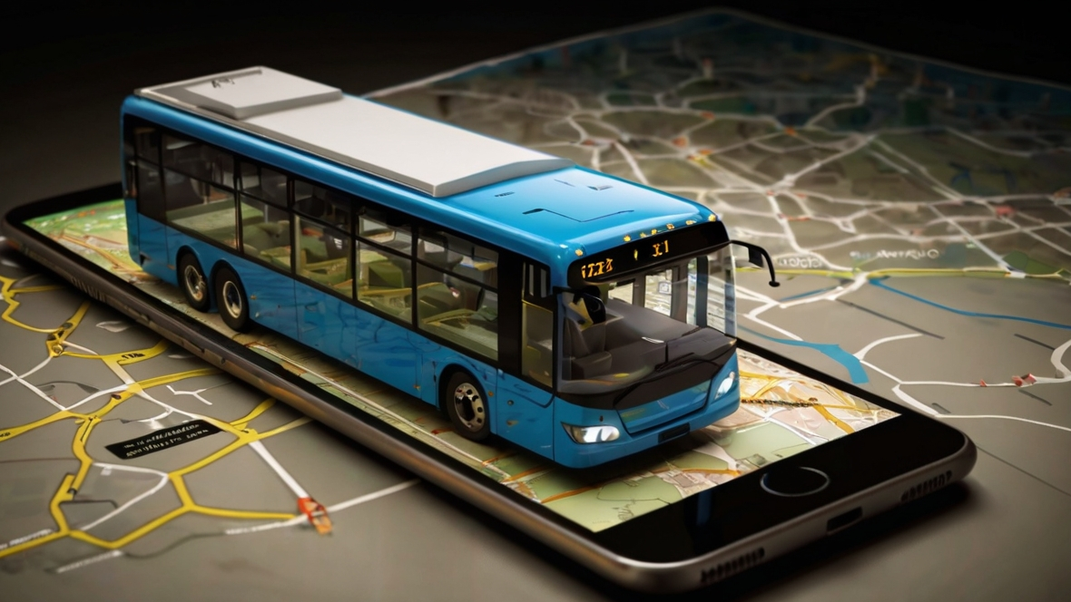

e-Conductor
Group 09
(Next Level of Sri Lankan Public Transport)
Department of Computer Engineering
Faculty of Engineering
University of Peradeniya
Sri Lanka

Slide 2
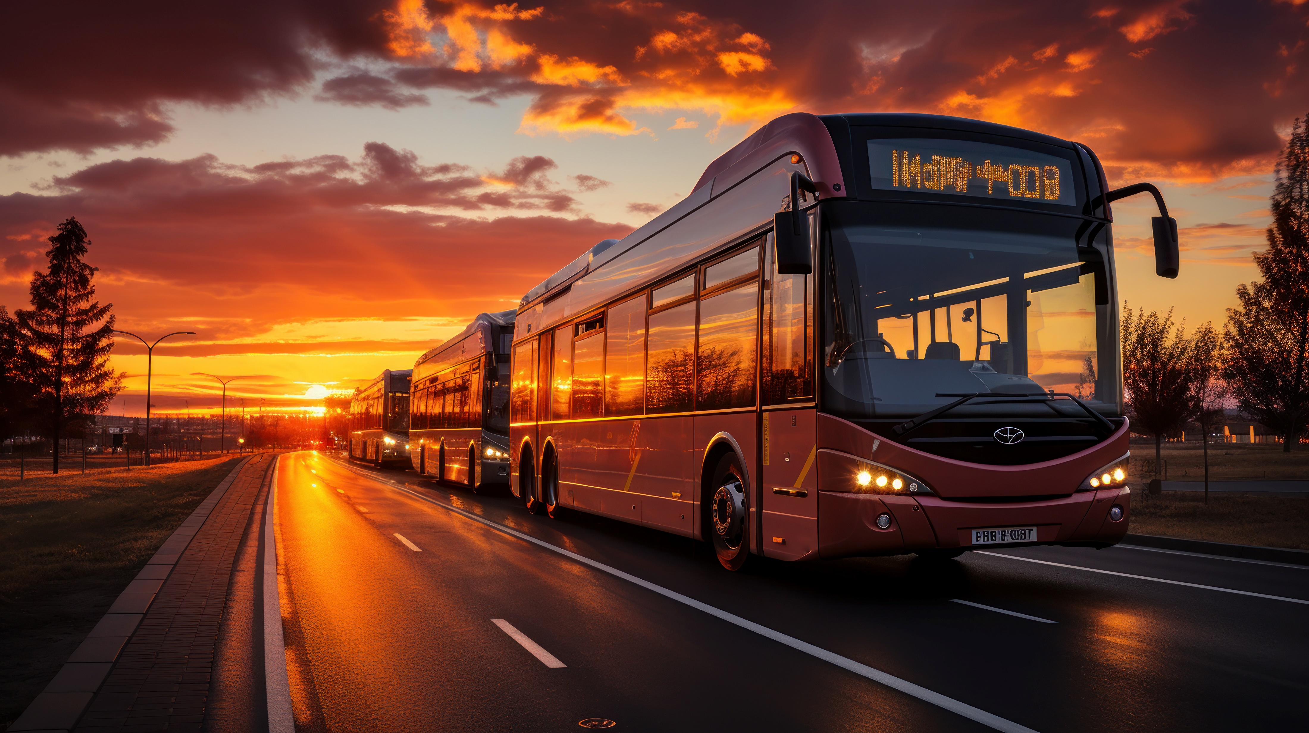
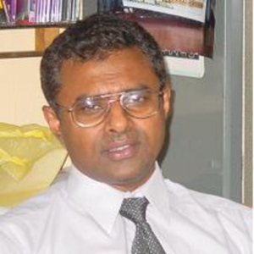
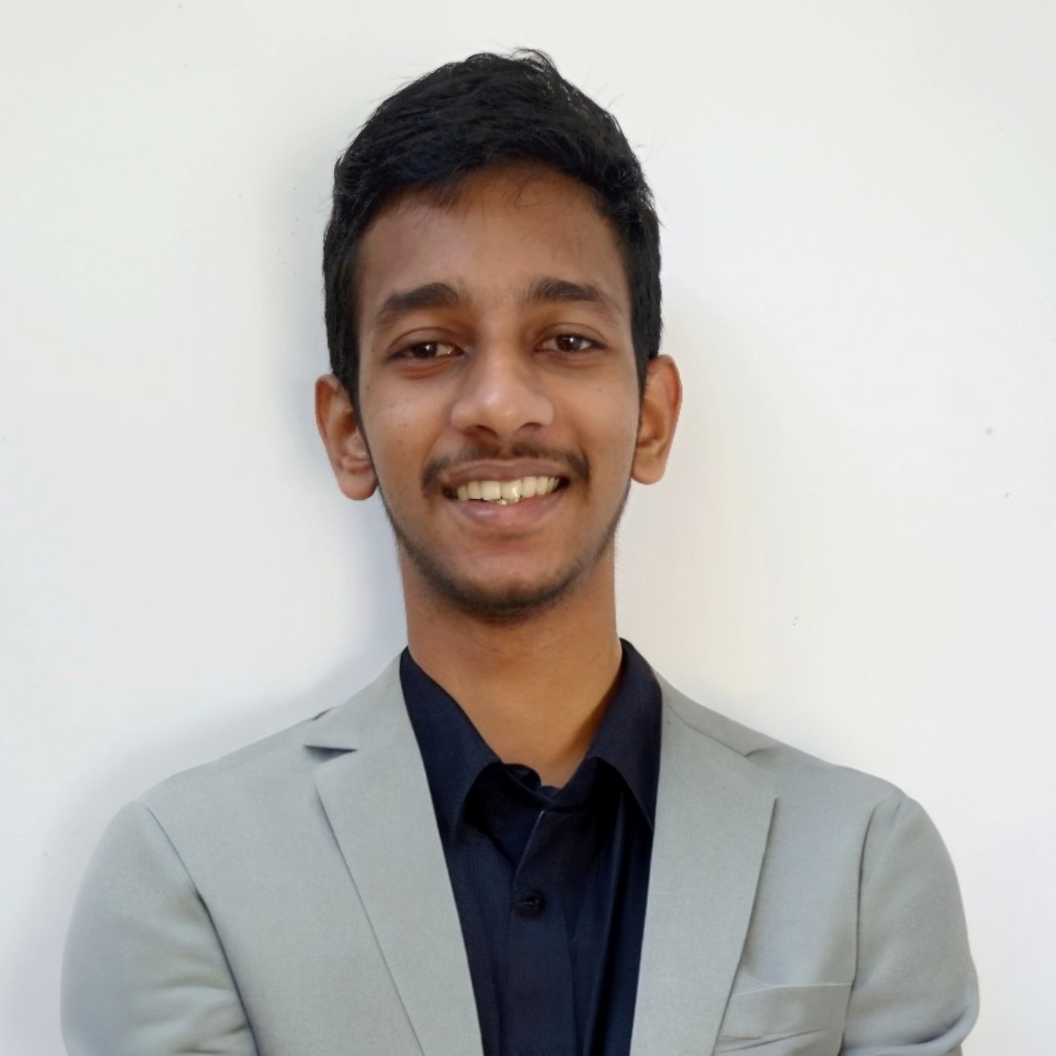


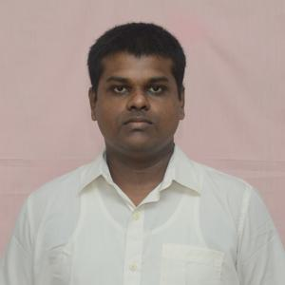
OUR TEAM
SUPERVISOR
Prof. Manjula Sandirigama
E/20/032
Bandara A.M.N.C.
E/20/035
Bandara K.C.H.N.A.W.M.R.C.J.N.
E/20/133 Haththella H.A.D.T.N.
E/20/157
Janakantha S.M.B.G.

Slide 3
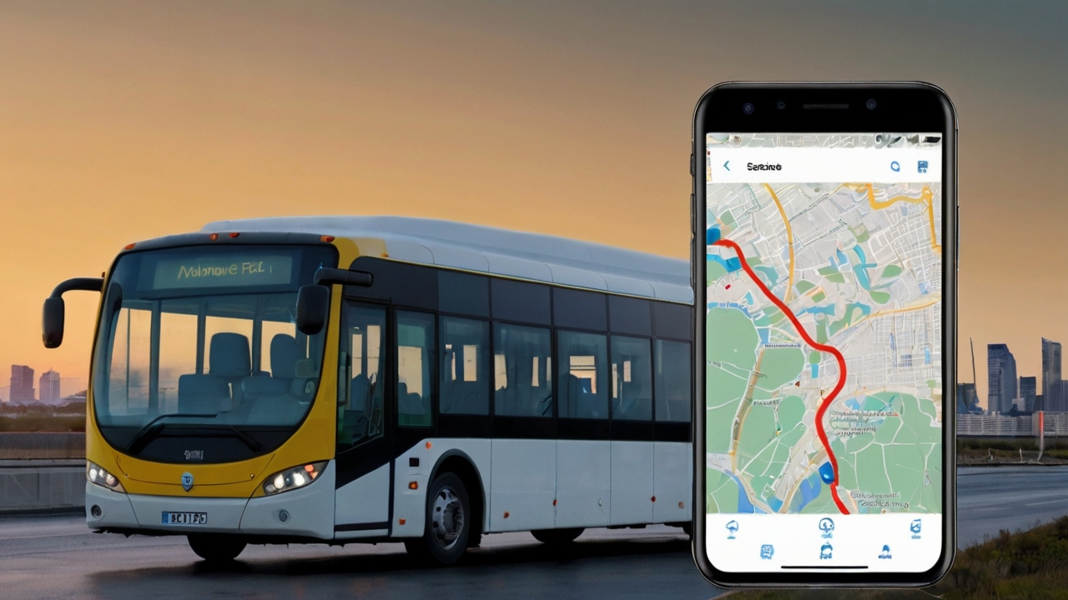
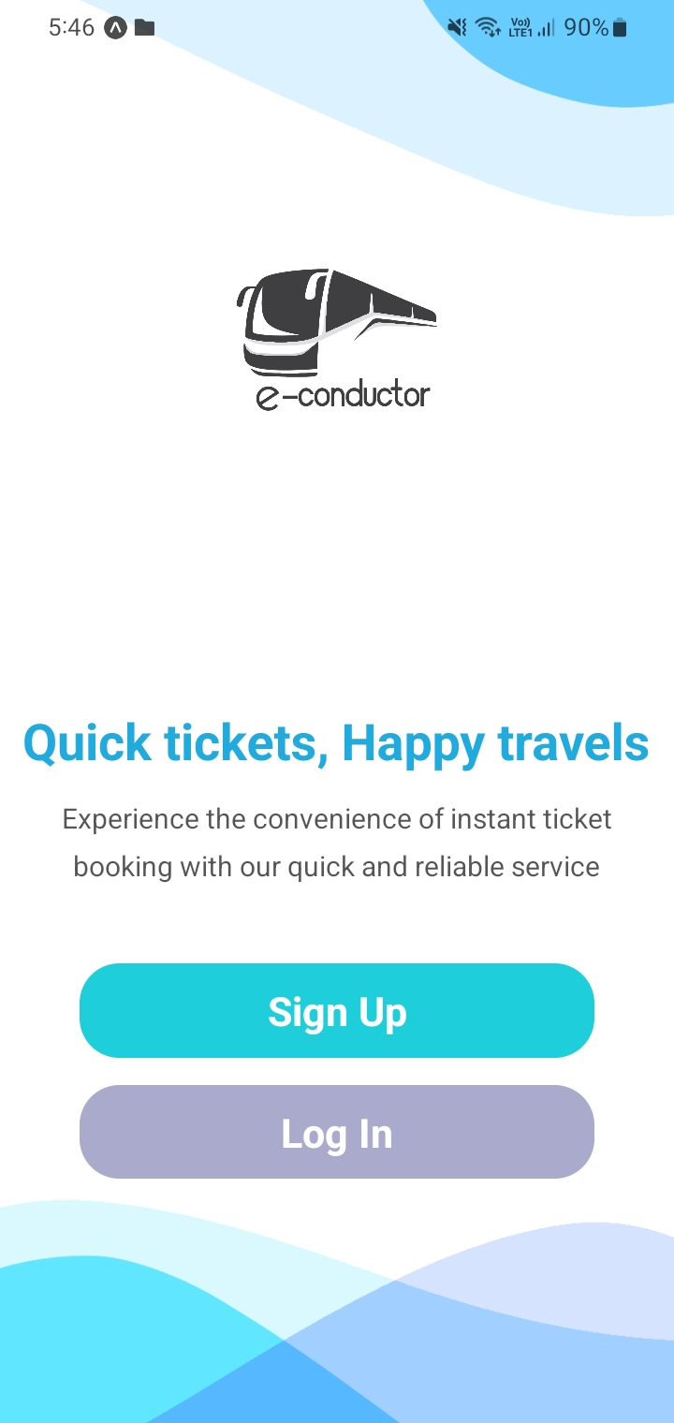





INTRODUCTION
Provide a convenient online platform
Streamline booking process, enhance user experience.
Search routes, select seats, live location tracking
Convenience, ease of use compared to traditional methods.
Improving accessibility to bus travel

Slide 4
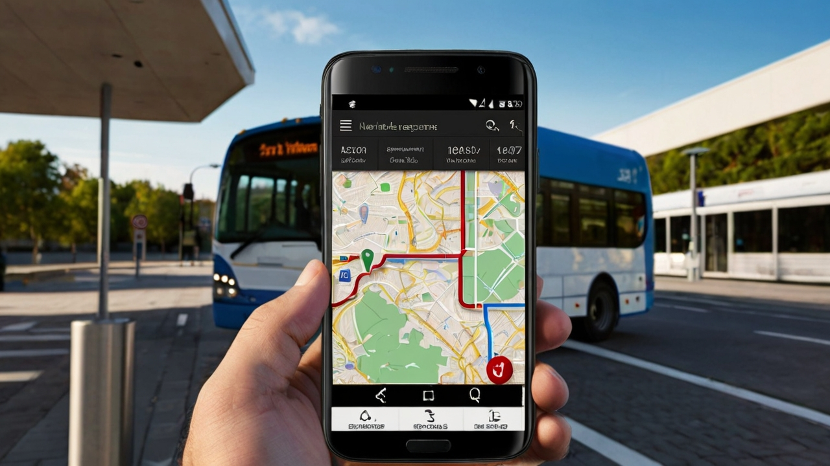



REQUIREMENTS OVERVIEW

Slide 5
FUNCTIONAL
User Registration
User Login
Route Searching
Seat Selection
Booking
Payment
Verification
Rating

Slide 6
NON FUNCTIONAL
Performance Metrics
Security Measures
Scalability
Usability

Slide 7
CONSTRAINTS & ASSUMPTIONS
CONSTRAINTS
Budget Constraints
Device Capabilities
Regulatory Compliance
ASSUMPTIONS
Open Source Software
Reliable Connection
Privacy Policy

Slide 8
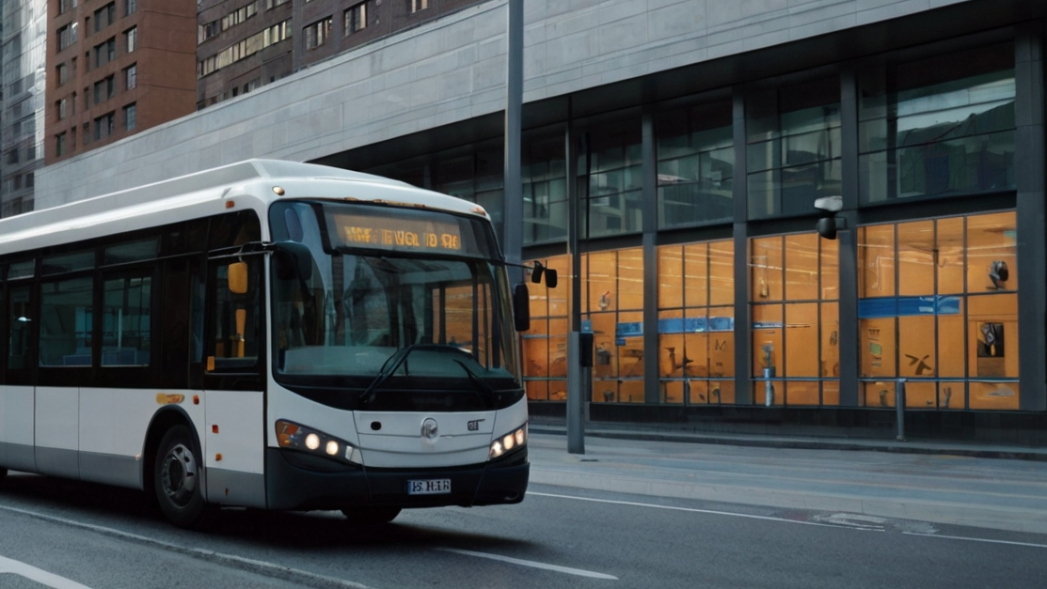












SYSTEM ARCHITECTURE

Slide 9
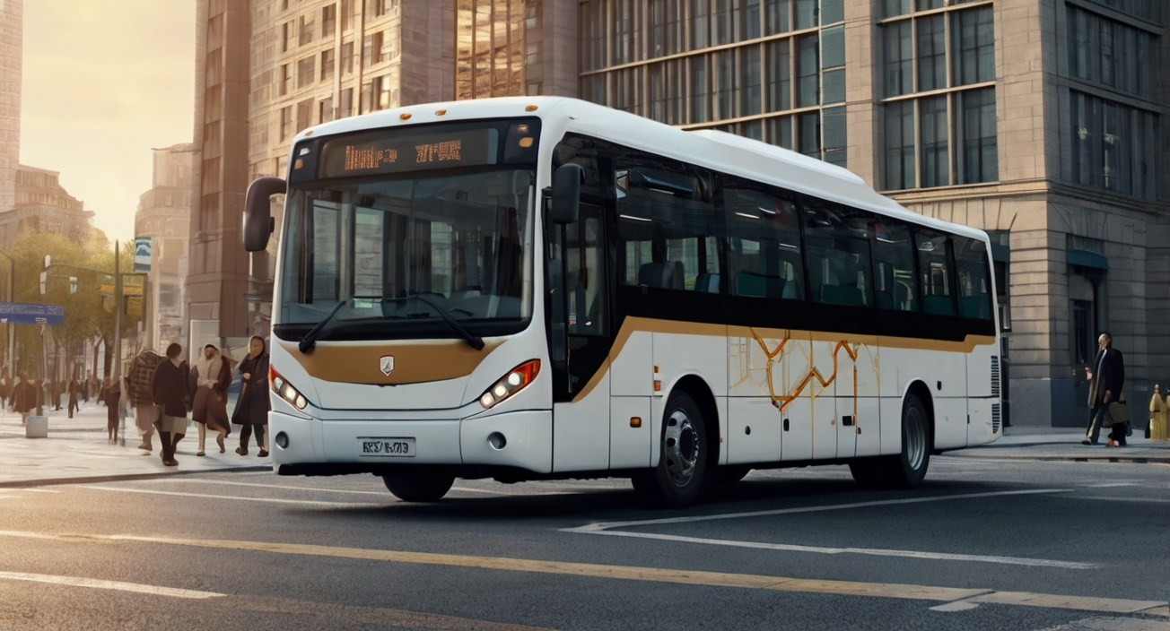
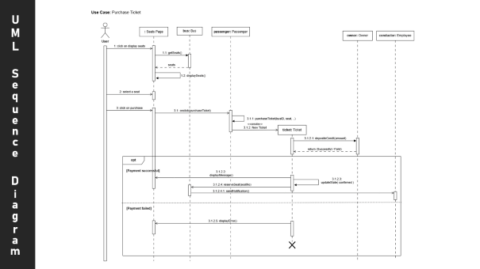
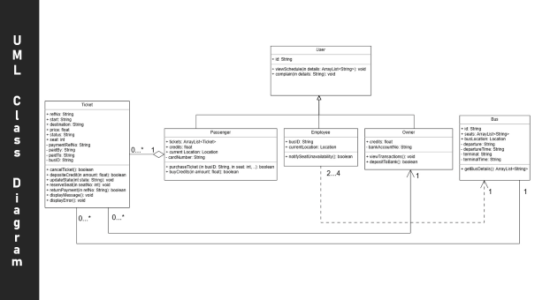
DETAILED DESIGN
UML Class Diagram
UML Sequence Diagram

Slide 10
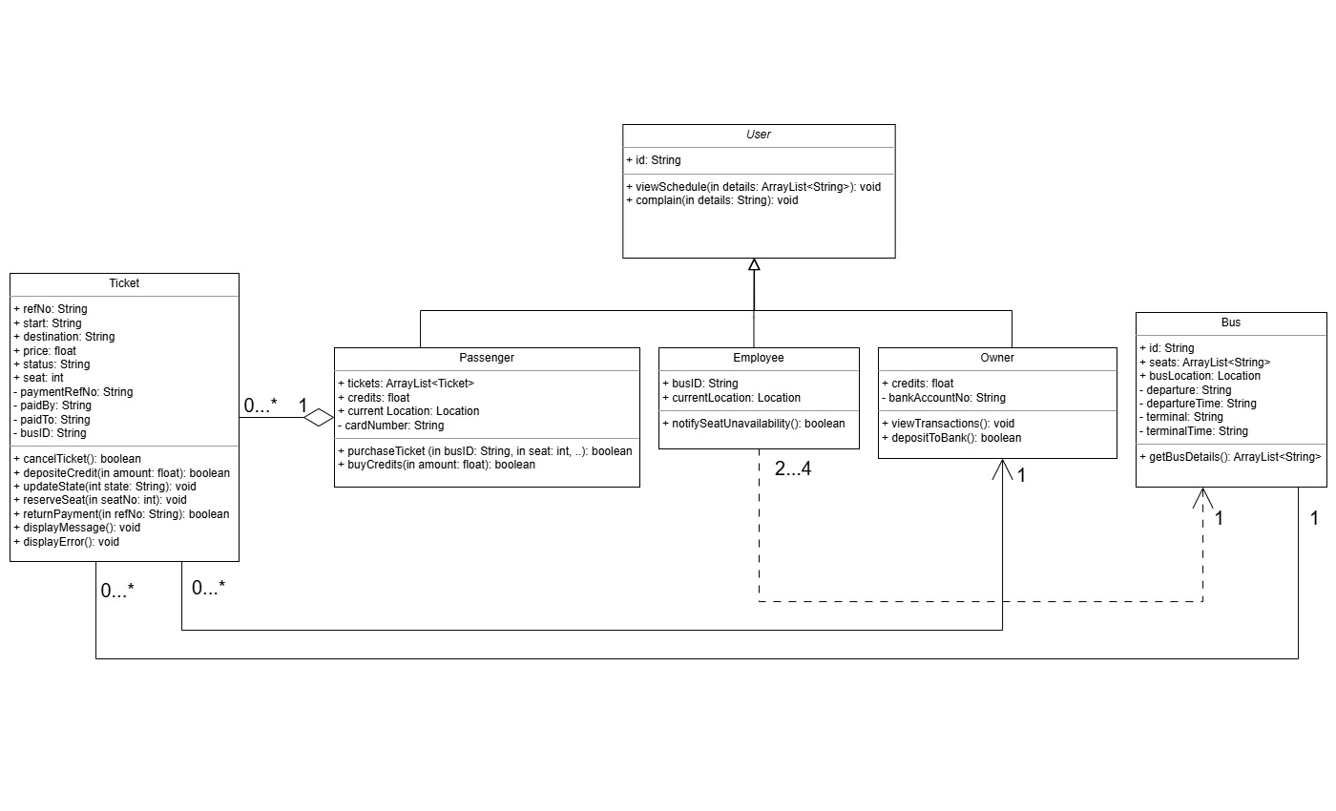
UML Class Diagram

Slide 11
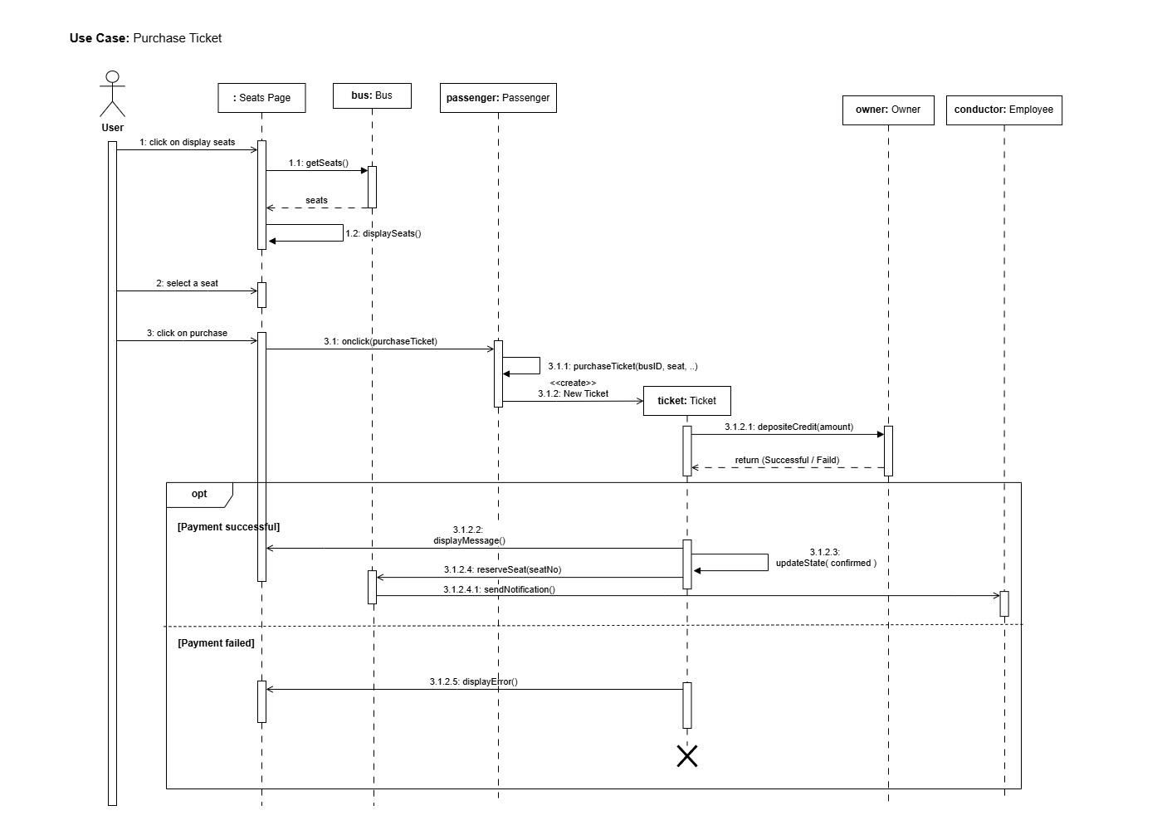
UML Sequence Diagram

Slide 12
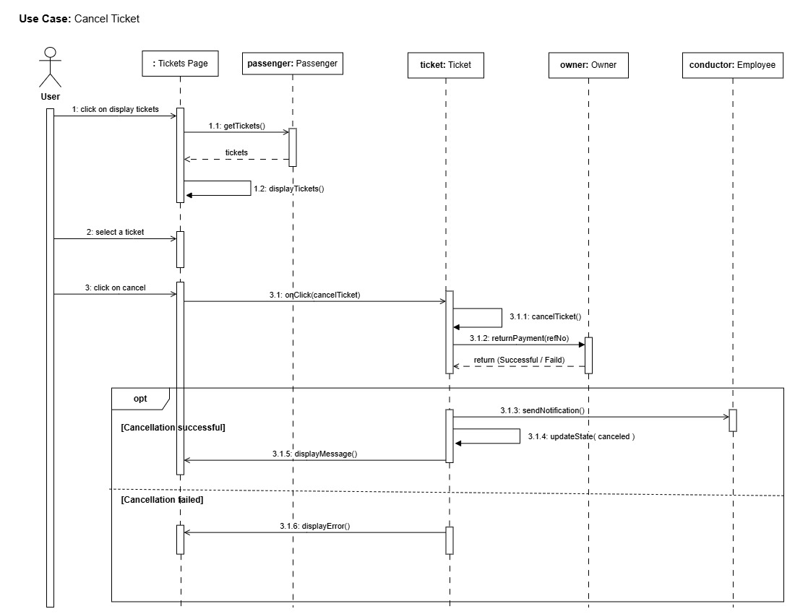
UML Sequence Diagram

Slide 13
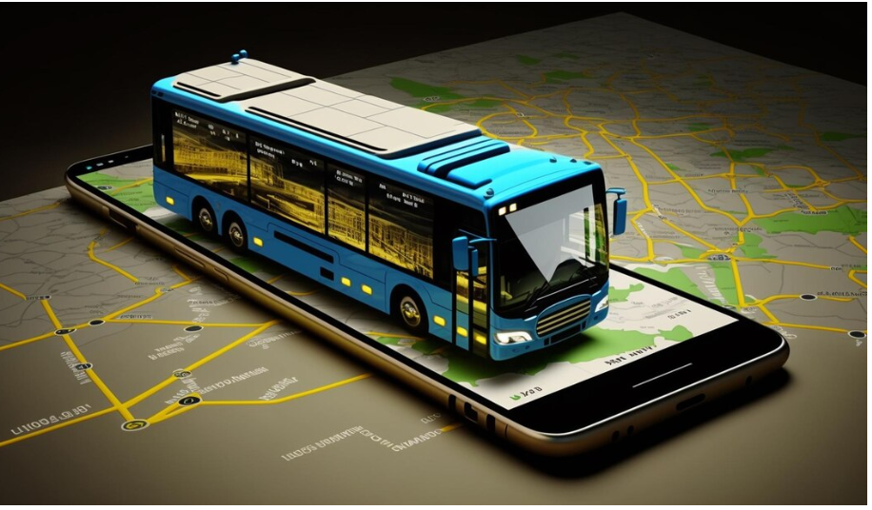
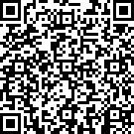
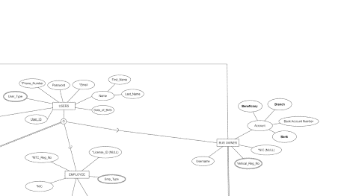
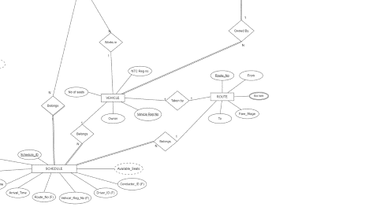
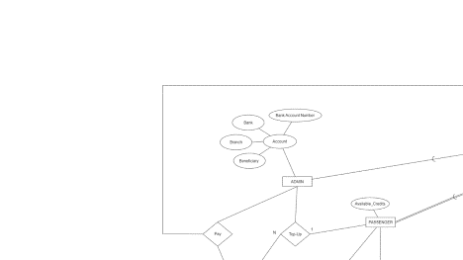
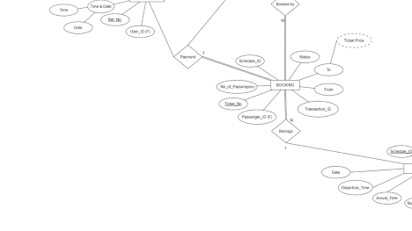
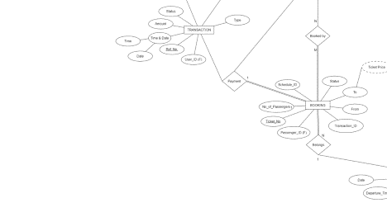
DATA MODEL
EER Diagram

Slide 14
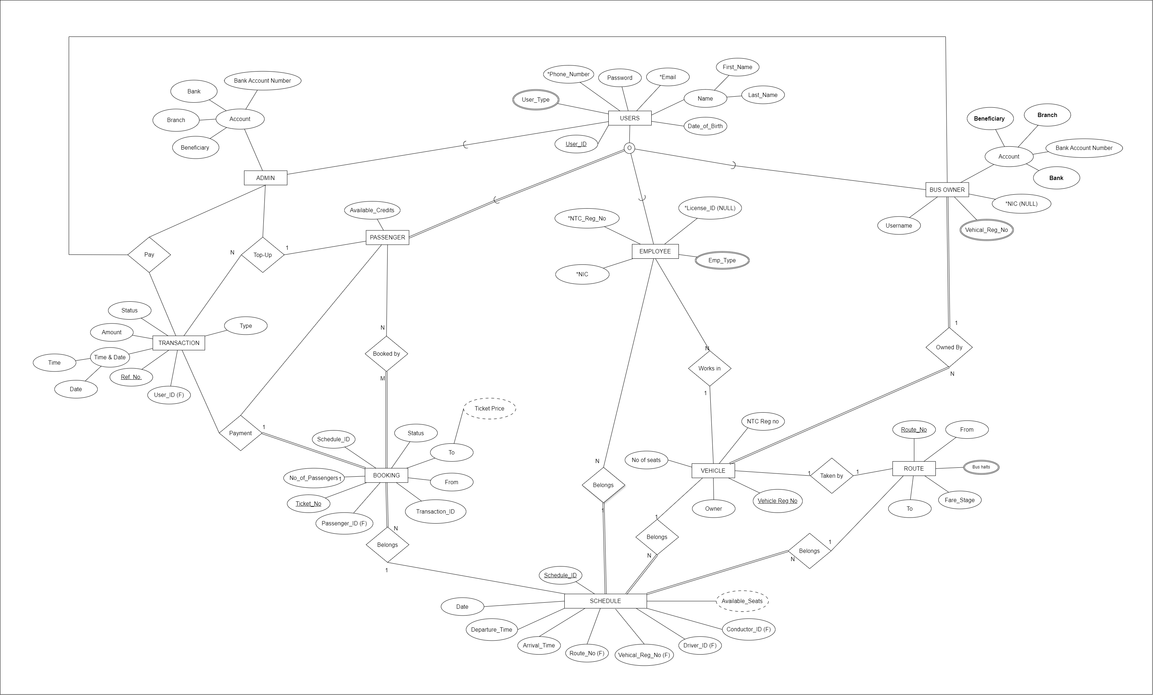

Slide 18
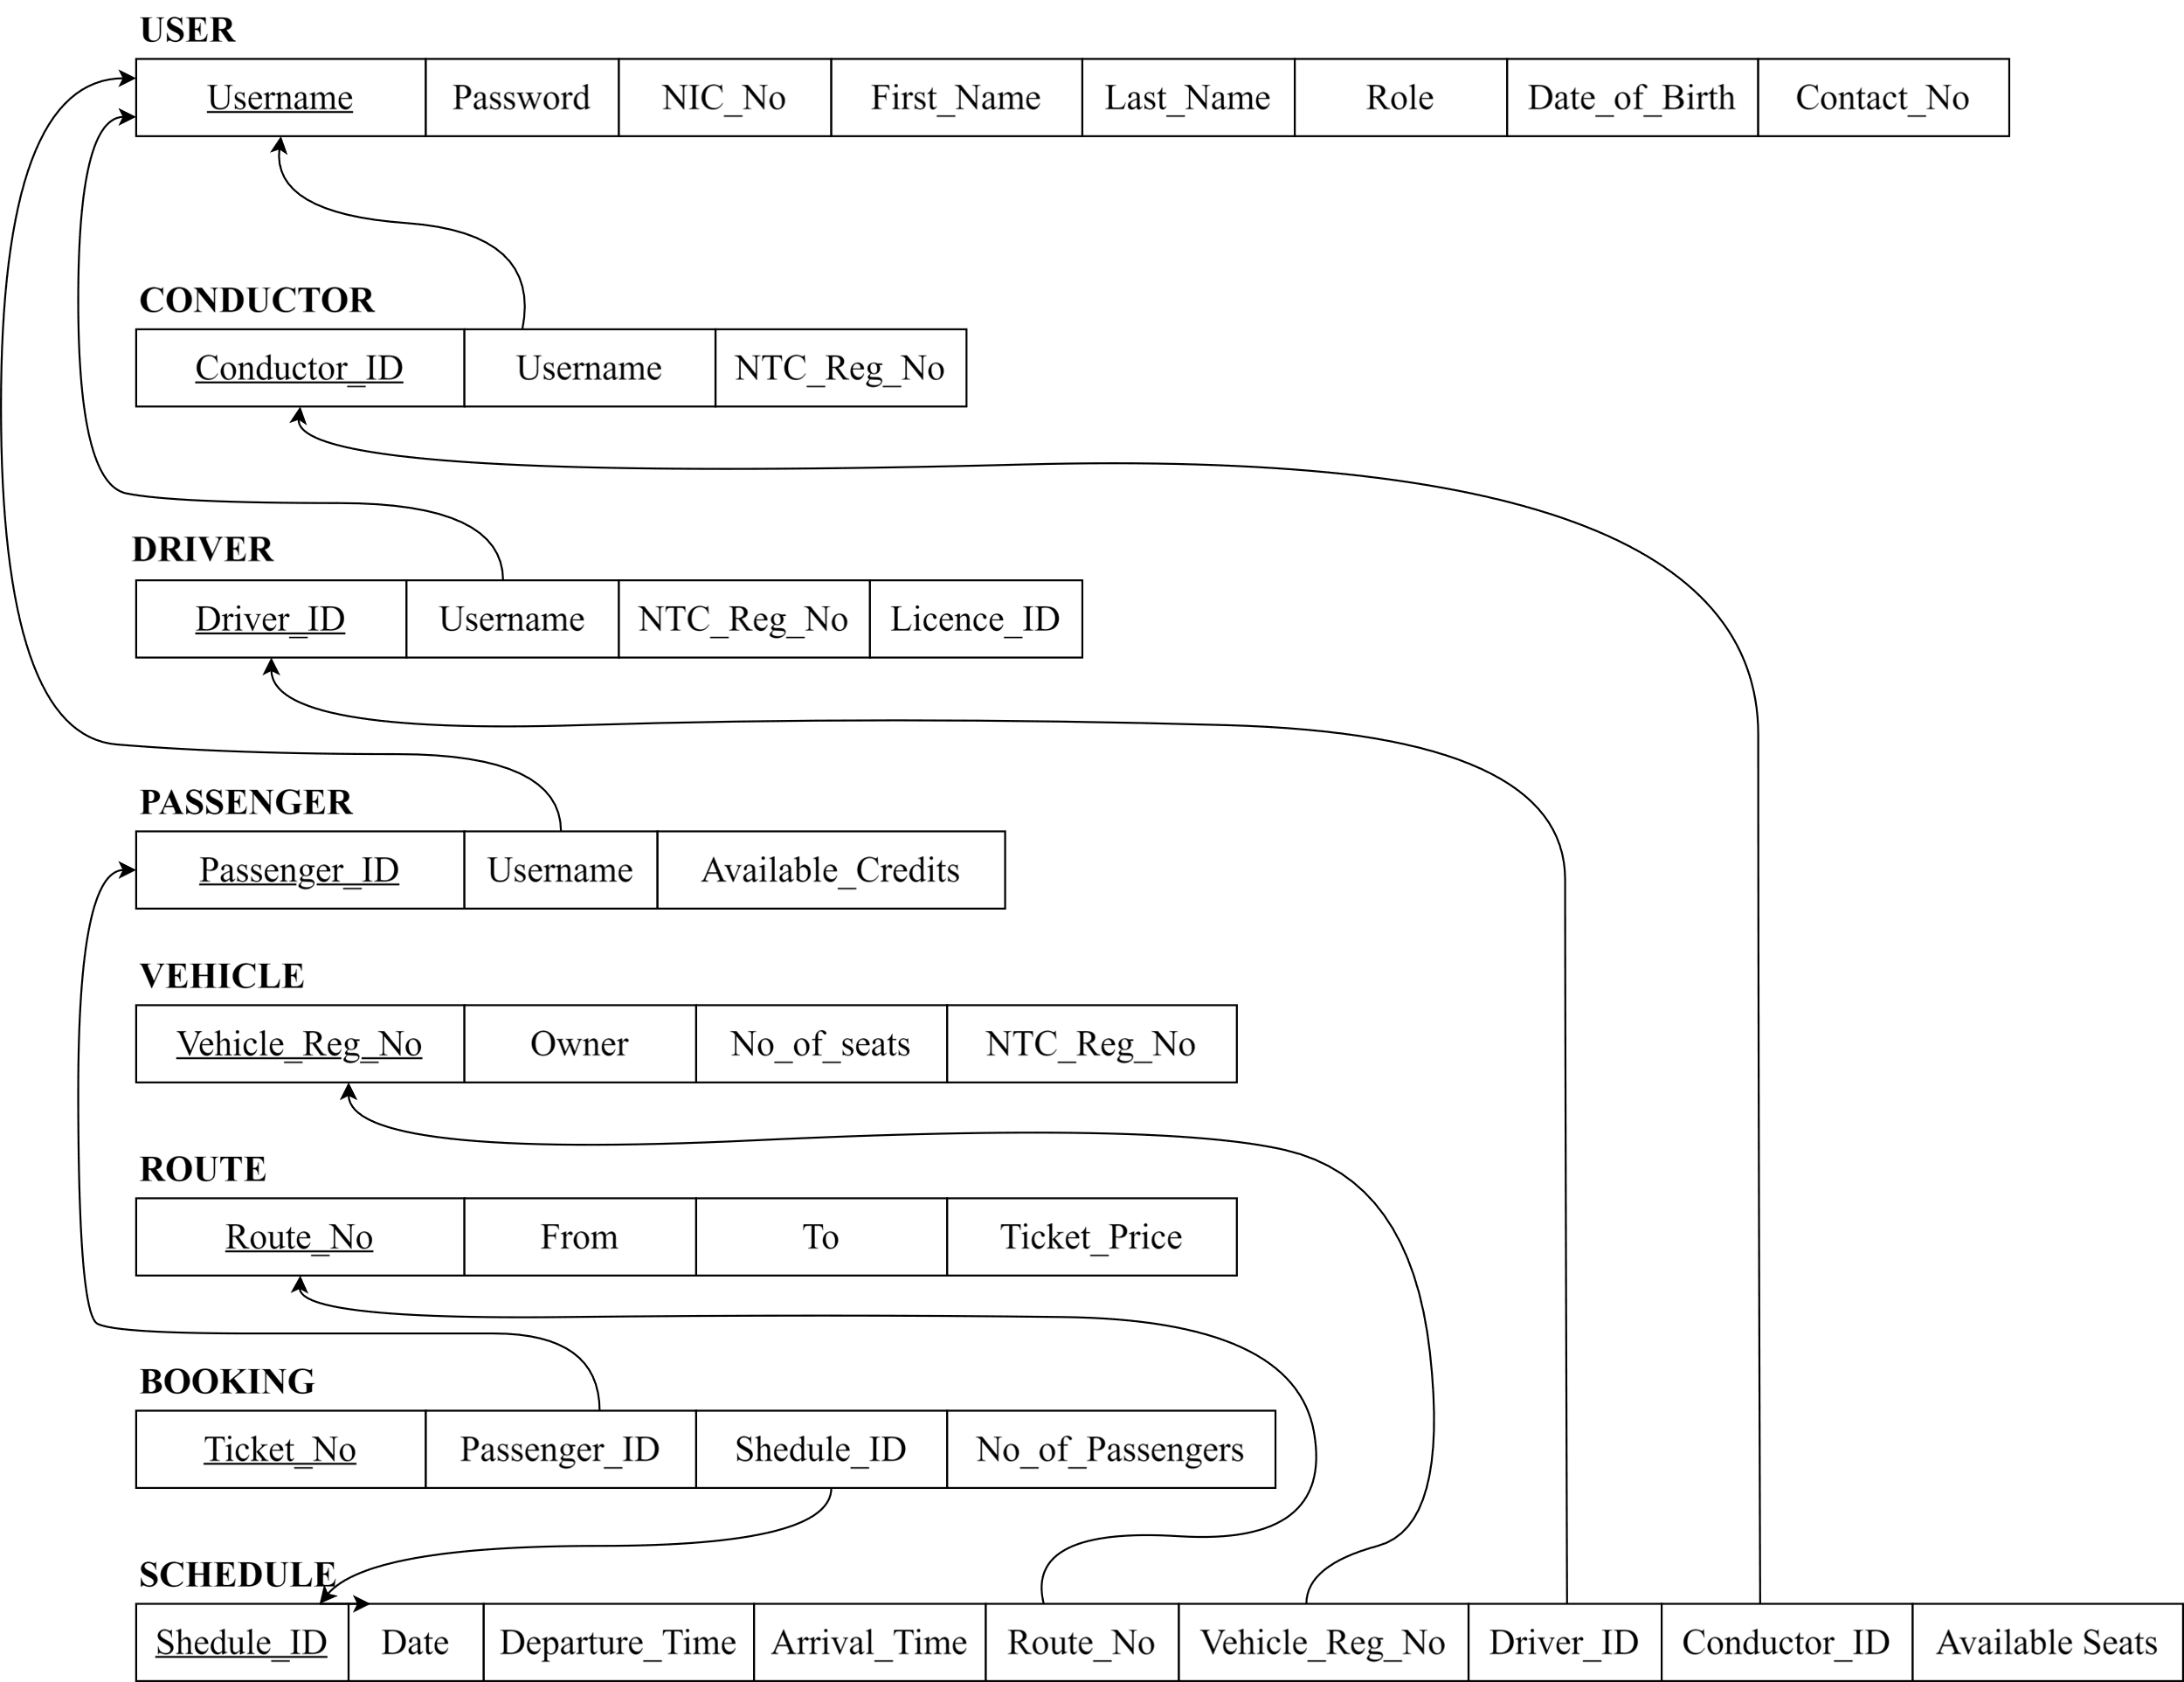
Relational Diagram

Slide 19
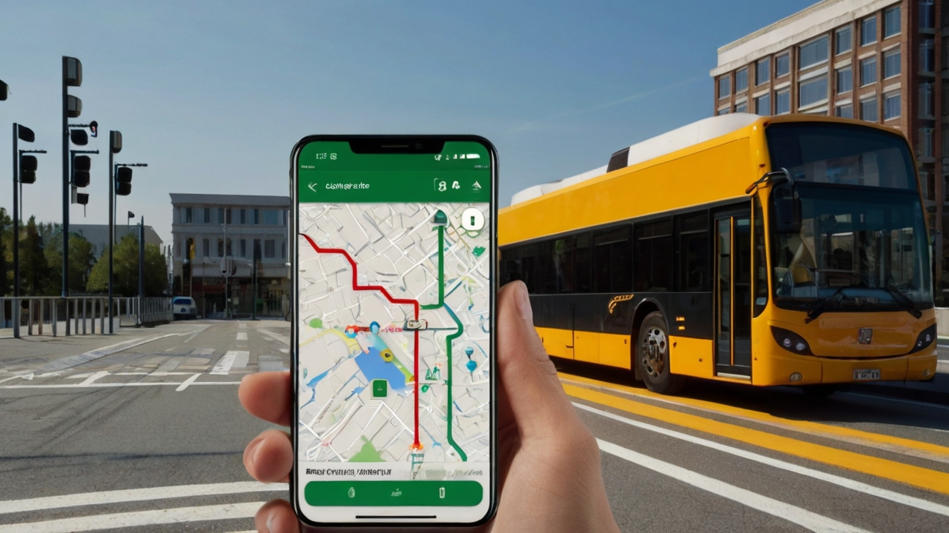





HIGHLIGHTS
Developer Tools
Hosting
Location Tracking System
Real-time Seat Availability Updates
Secure Payment Processing

Slide 20
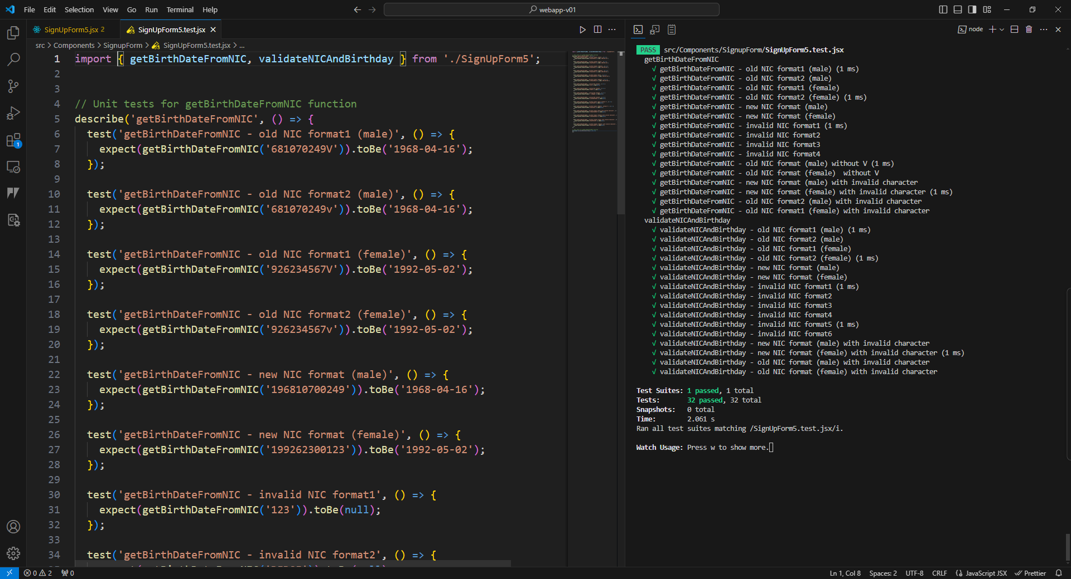



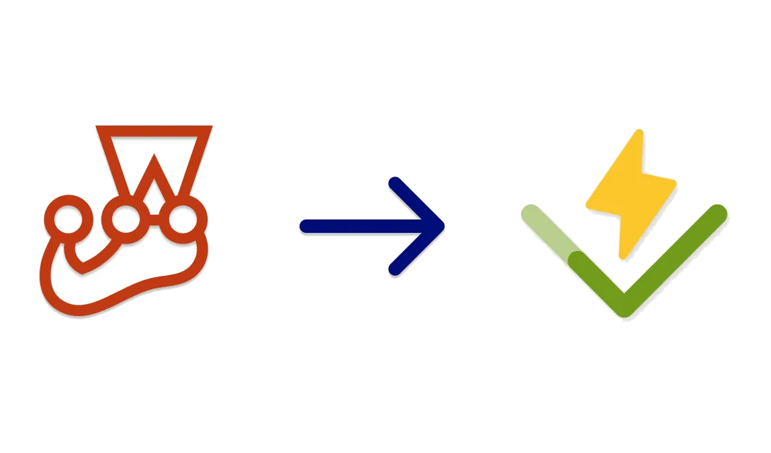
TESTING

Slide 21
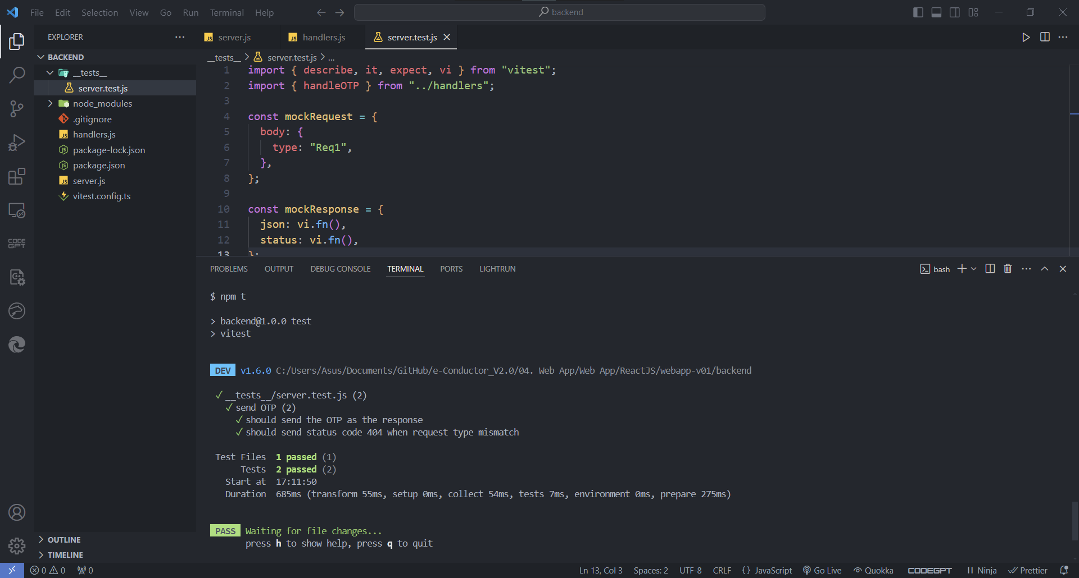
TESTING

Slide 22
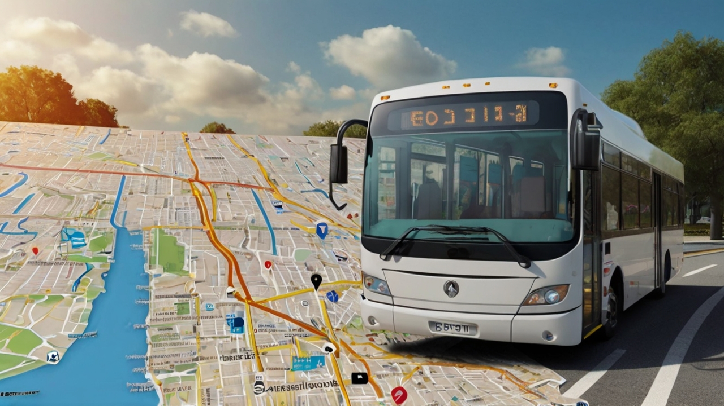
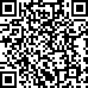


DEMONSTRATION
OVERALL PROGRESS
OTP: eco123
Web
App
Mobile App
Database
Backend

Slide 23
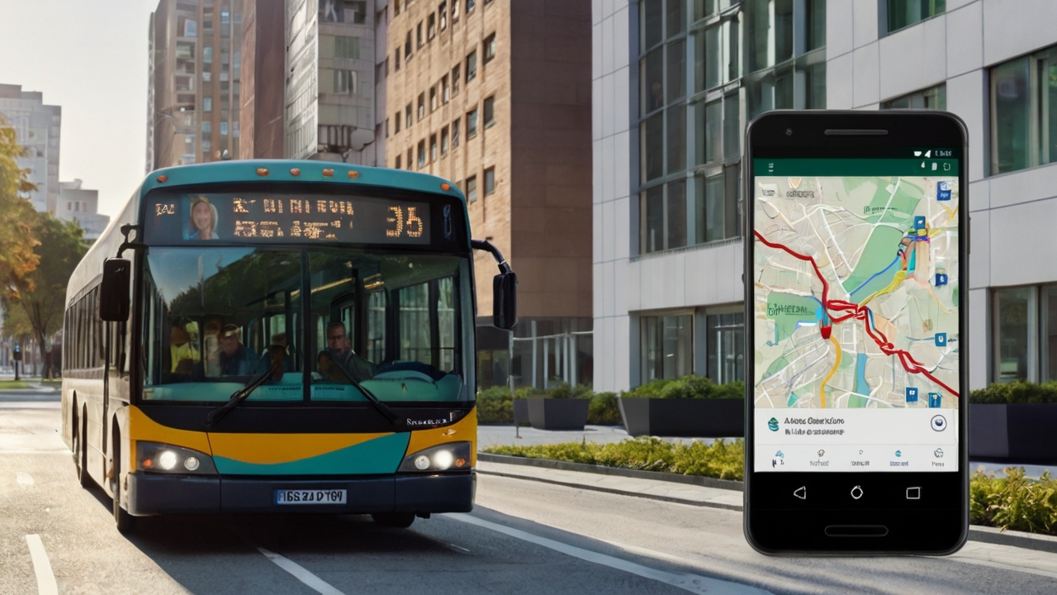





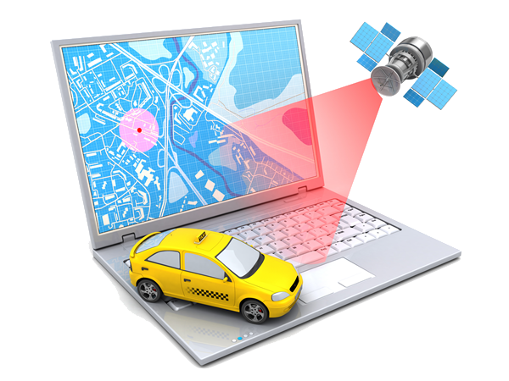
FUTURE WORK
THANK YOU
Web App
Mobile App
Database
Testing & Debugging
Payment Gateway
App Launching
Backend
Live Location Tracking

Slide 24
THANK YOU
Web App
Mobile App
Database
Testing & Debugging
Payment Gateway
App Launching
Backend
Live Location Tracking

